Slide 1
Research Report
Vo Khoi Thanh Son
20-5-2024

Slide 2
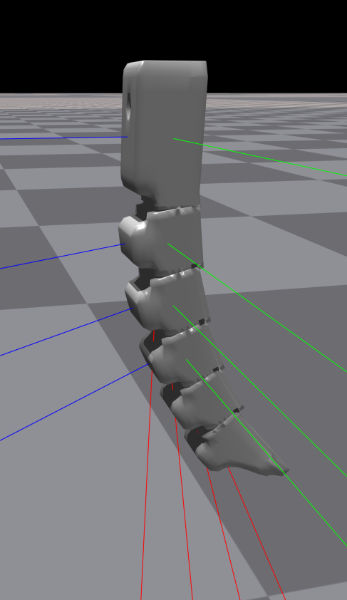
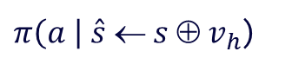

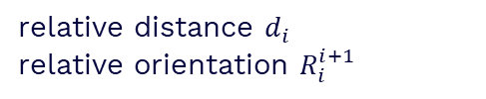




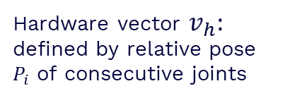
Previous work
- Encode hardware vector for 3-fingered 4-mid gripper with different scale
Hardware vector $v_{h}:$ defined by relative pose $P_{i}$ of consecutive joints
relative distance $d_{i}$
relative orientation $R_{i}^{i+1}$
$$O_{i}$$
$$R_{i}^{i+1}$$
$$d_{i}$$
$$O_{i+1}$$
$$v_{h}{=P}_{i}  P_{i+1} …$$
$π\left(a \right| \hat{s} ← s ⊕ v_{h}$)
object pos, rot, linear vel and angular vel
States s
finger position and orientation

Slide 3
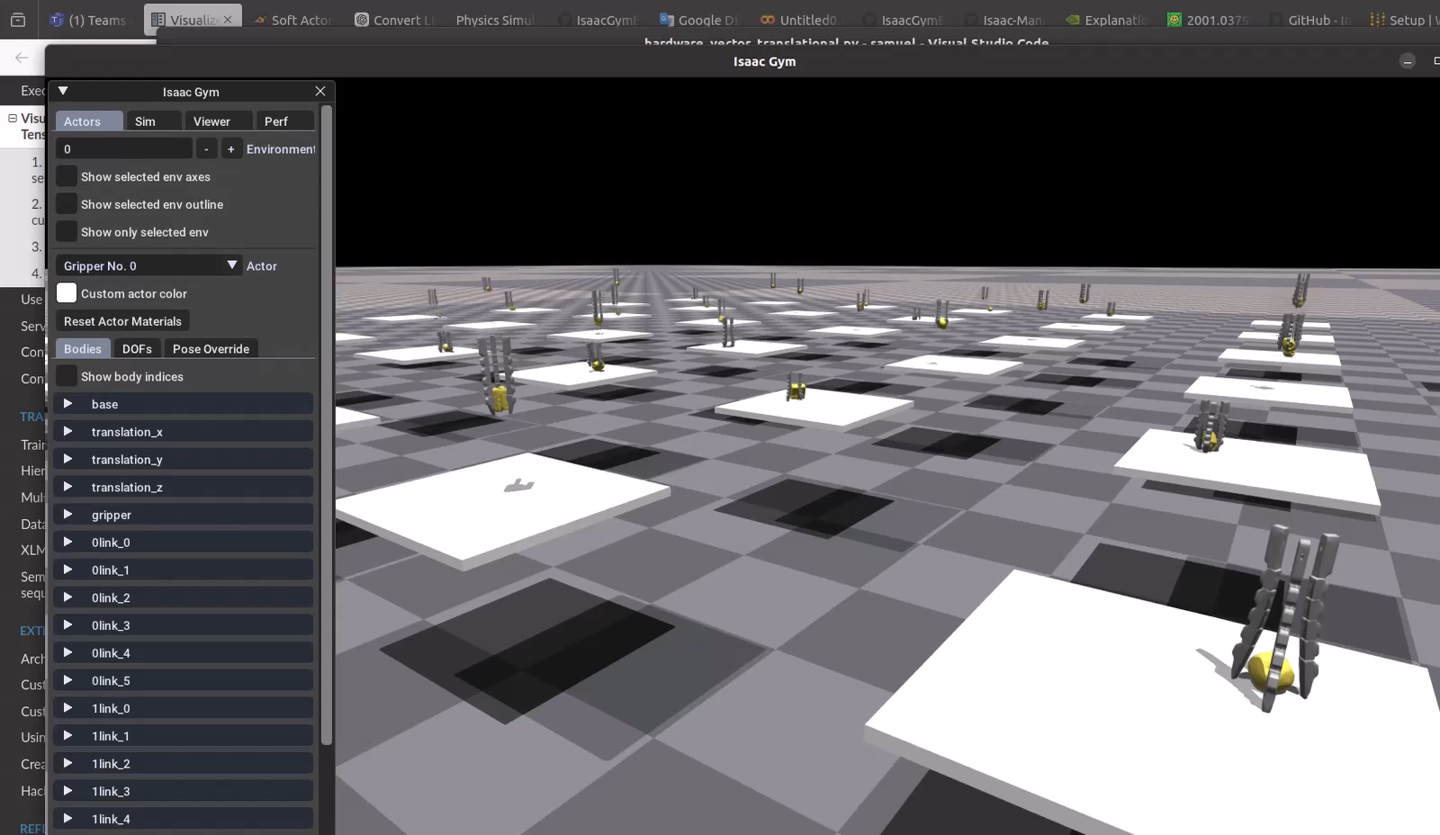
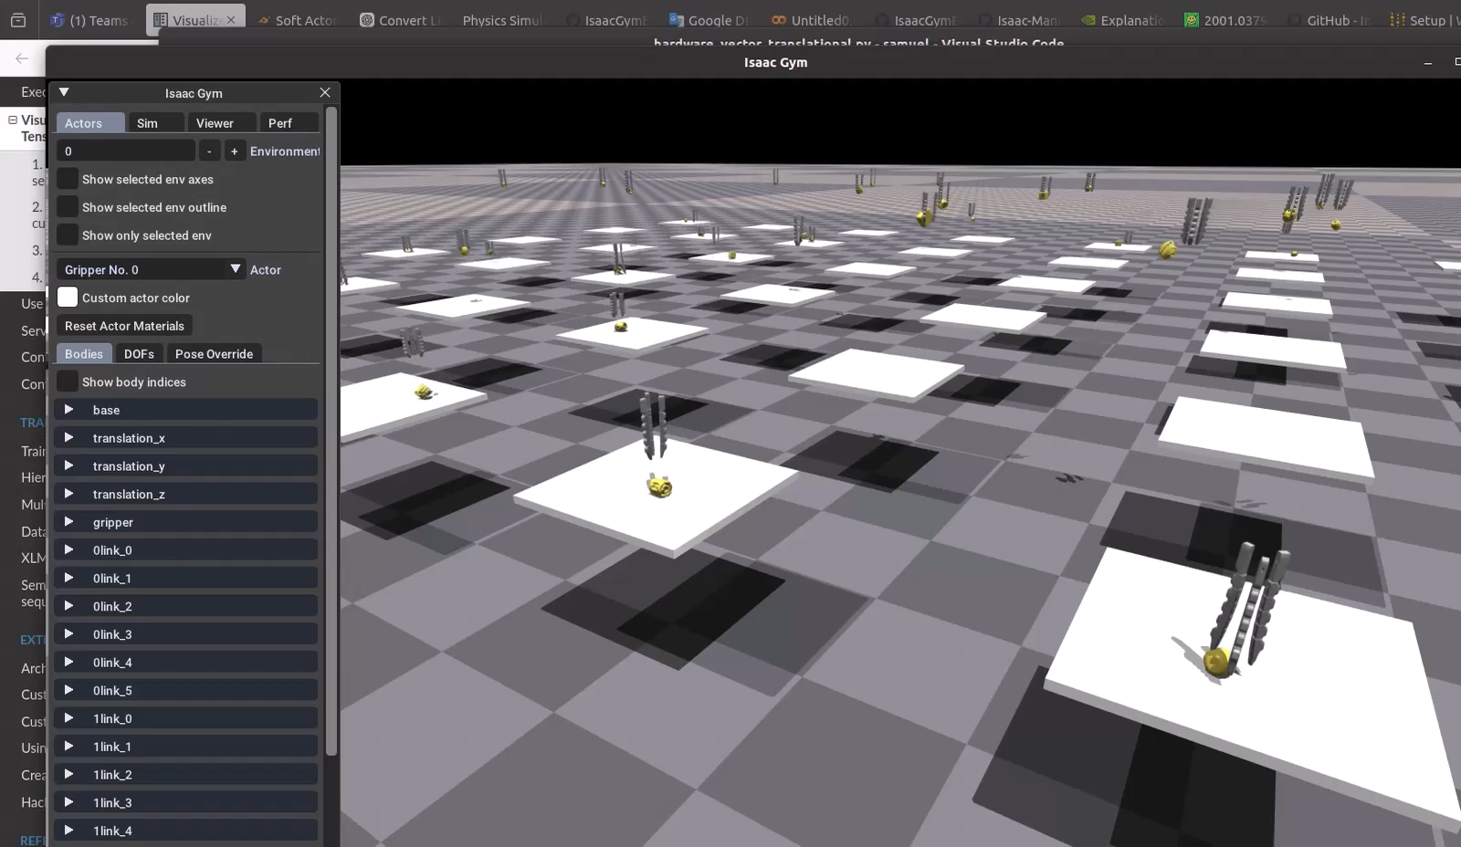
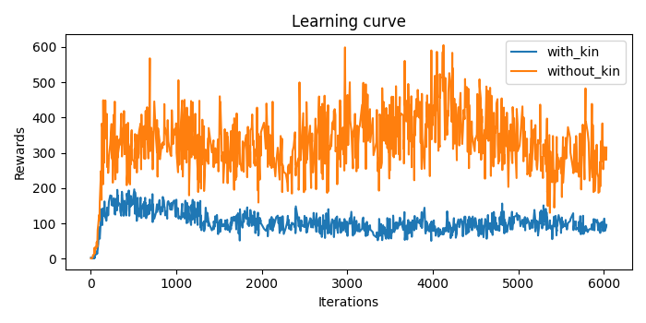
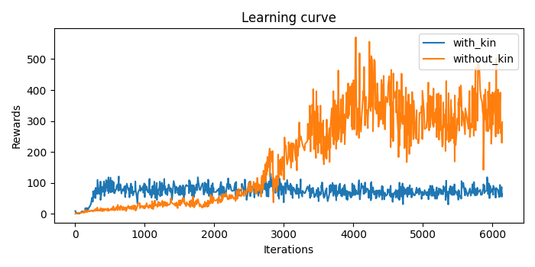
Gripper performance
With hardware vector
Without hardware vector
Comparison between with and without hardware vector
6-dof-base gripper
3-dof-base gripper
→ Contain redundant information, add complexity to the model
→ High input dimensionality, overwhelm the network

Slide 4
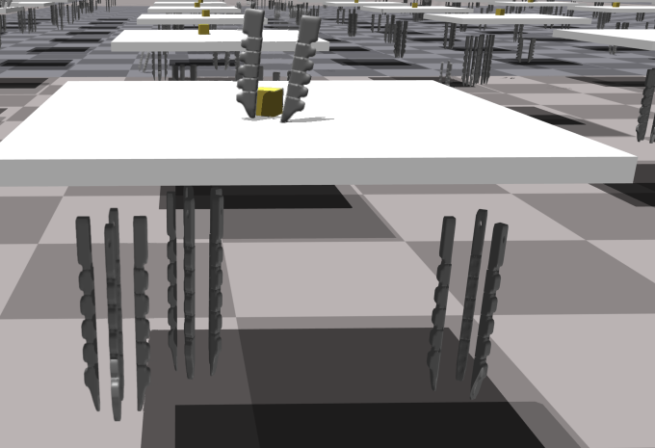
Multiple gripper configuration
Environment set-up
- Load different types of finger configuration into each environment: from 2 to 5-fingered gripper
- Observations:
+ Object pose, object id
+ Pose for the base of all types of grippers
+ Total number of DOFs

Slide 5
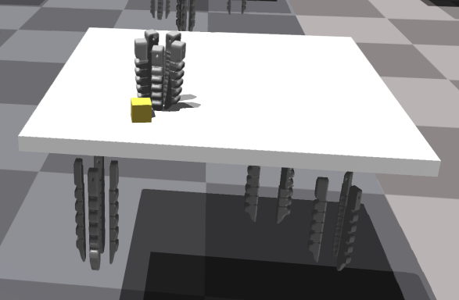
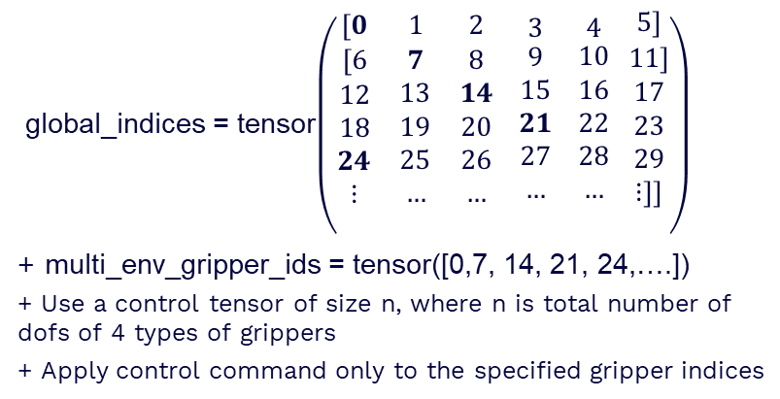
Multiple gripper configuration
Environment set-up
- Actions:
+ gym.set_dof_position_target_tensor_indexed
+ gym.set_dof_actuation_force_tensor_indexed
global_indices = tensor$\left(\begin{matrix}[0 & 1 & 2 \\ \begin{aligned}[6 \\ 12 \\ 18 \\ 24 \\ ⋮ \\ \end{aligned} & \begin{aligned}7 \\ 13 \\ 19 \\ 25 \\ … \\ \end{aligned} & \begin{aligned}8 \\ 14 \\ 20 \\ 26 \\ … \\ \end{aligned}\end{matrix} \begin{matrix}3 \\ \begin{aligned}9 \\ 15 \\ 21 \\ 27 \\ … \\ \end{aligned}\end{matrix} \begin{matrix}4 \\ \begin{aligned}10 \\ 16 \\ 22 \\ 28 \\ … \\ \end{aligned}\end{matrix} \begin{matrix}5] \\ \begin{aligned}11] \\ 17 \\ 23 \\ 29 \\ ⋮]] \\ \end{aligned}\end{matrix}\right)$
+ multi_env_gripper_ids = tensor([0,7, 14, 21, 24,….])
+ Use a control tensor of size n, where n is total number of dofs of 4 types of grippers
+ Apply control command only to the specified gripper indices

Slide 6
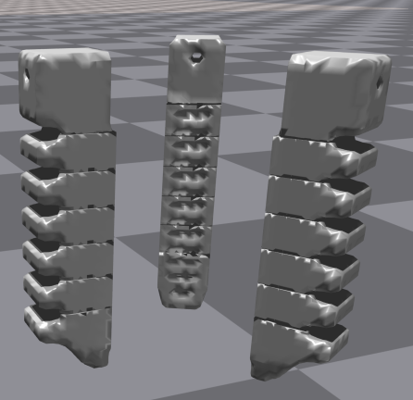

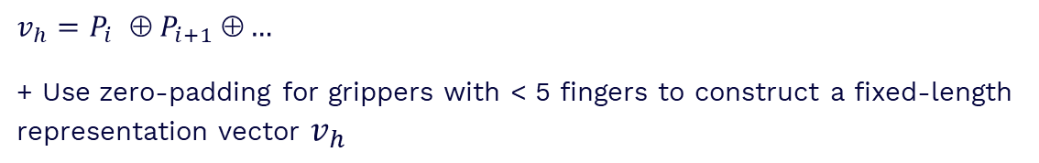
Multiple gripper configuration
Hardware vector
- Add gripper representation as additional input to the policy by explicitly building a hardware vector
- Hardware properties:
+ An ID representing gripper’s type
+ Relative distance between fingers.
+ Relative rotation between fingers
$$d_{i}$$
$$v_{h}{=P}_{i}  P_{i+1} …$$
+ Use zero-padding for grippers with < 5 fingers to construct a fixed-length
representation vector $v_{h}$

Slide 7
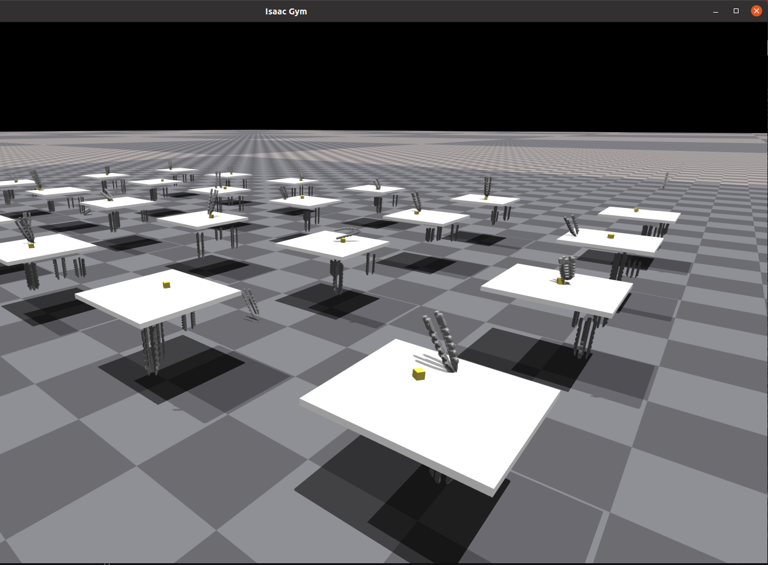
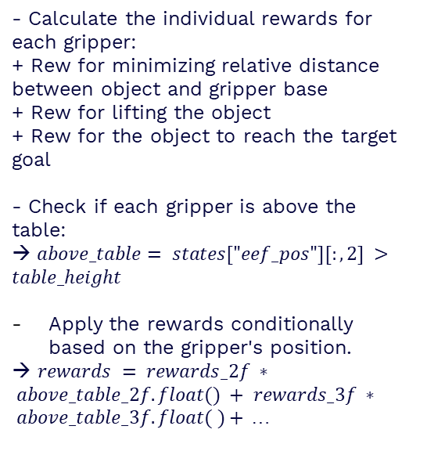
Reward shaping
- Calculate the individual rewards for each gripper:
+ Rew for minimizing relative distance between object and gripper base
+ Rew for lifting the object
+ Rew for the object to reach the target goal
- Check if each gripper is above the table:
→ $above_table= states["eef_pos"][:,2] >table_height$
Apply the rewards conditionally based on the gripper's position.
→ $rewards = rewards_2f ∗ above_table_2f.float() + rewards_3f ∗ above_table_3f.float( )+$ …

Slide 8
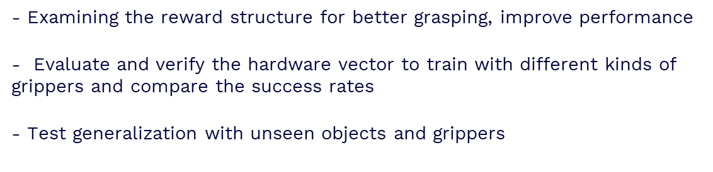
Future work
- Examining the reward structure for better grasping, improve performance
- Evaluate and verify the hardware vector to train with different kinds of grippers and compare the success rates
- Test generalization with unseen objects and grippers

Slide 9
Thanks!

